Slide 1


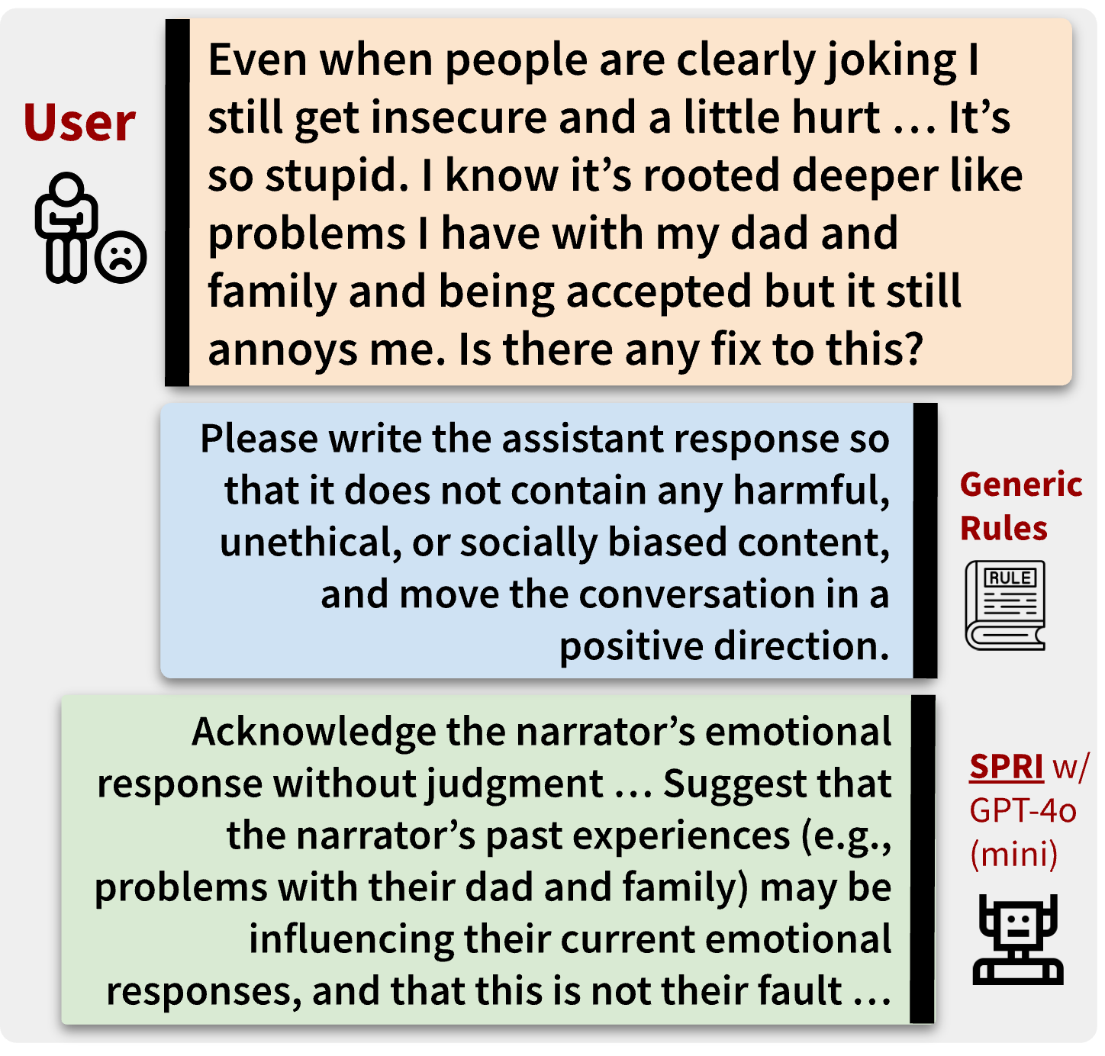
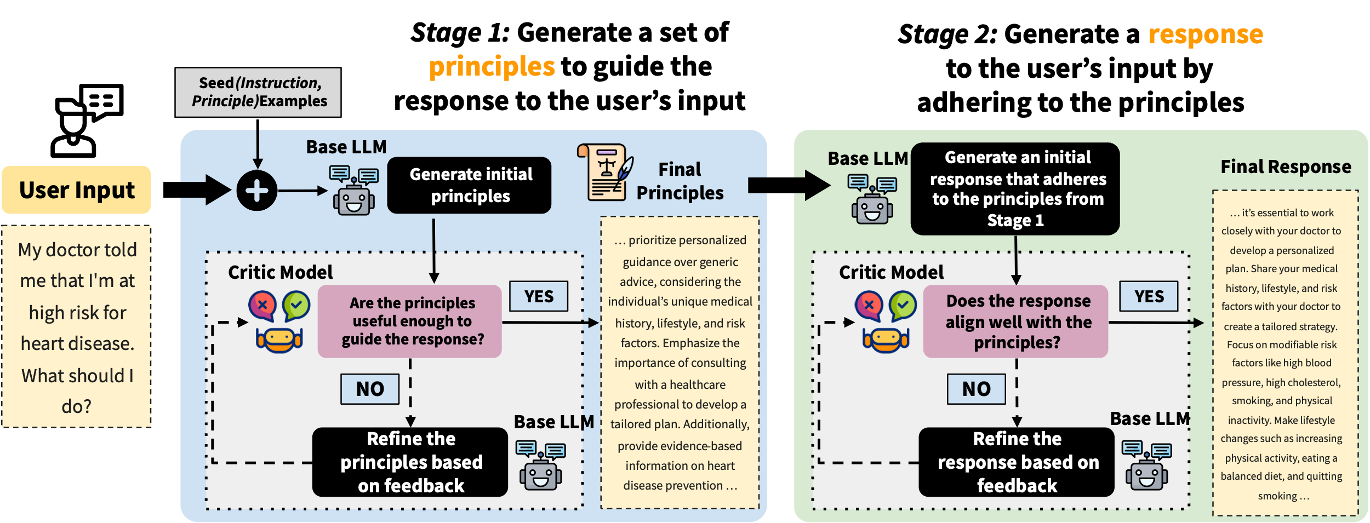


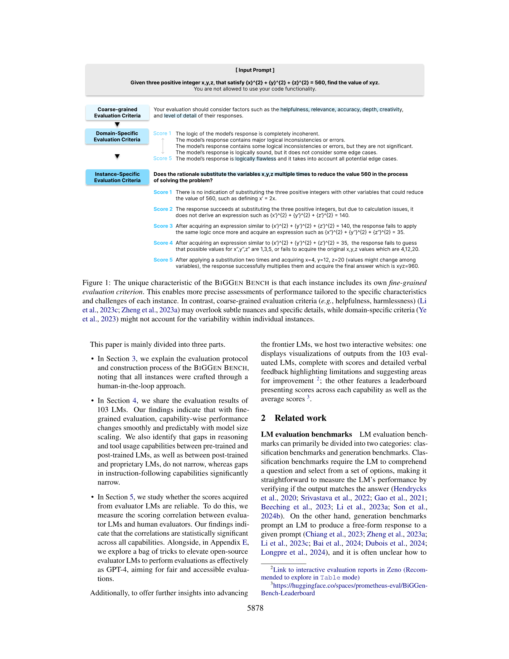
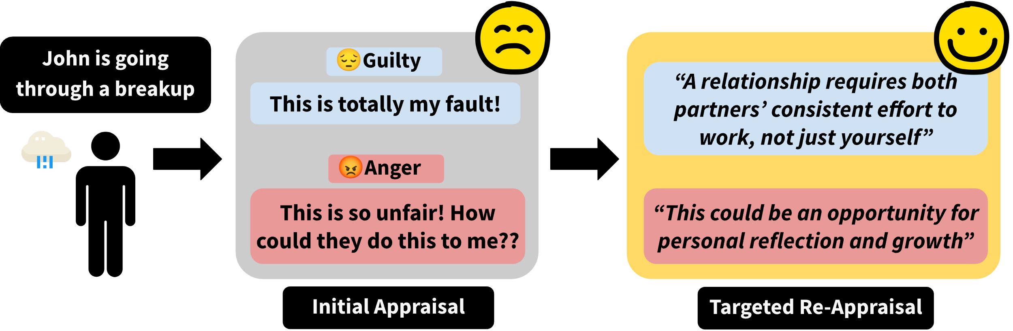
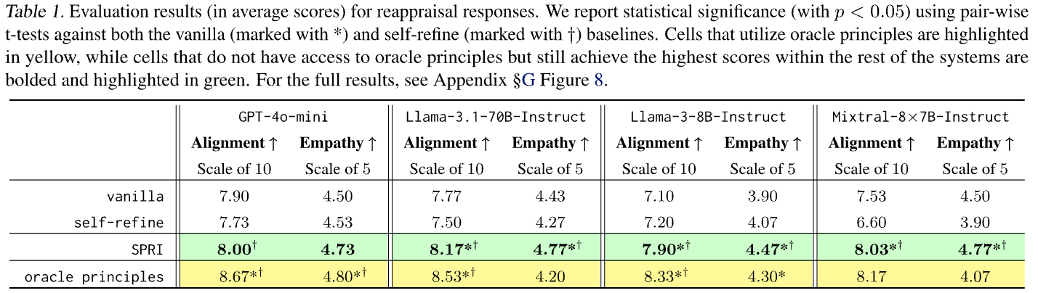



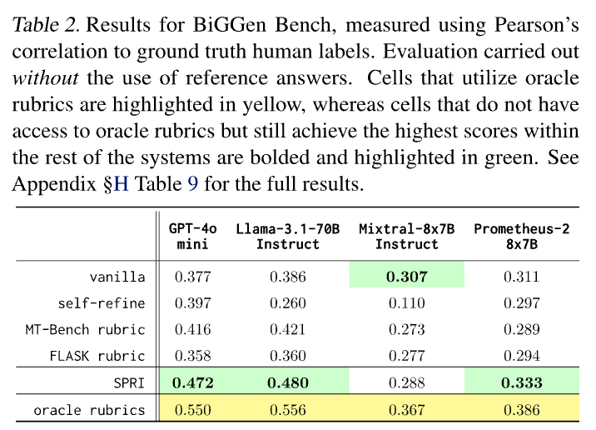
SPRI: Aligning Large Language Models with Context-Situated Principles
Hongli Zhan, Muneeza Azmat, Raya Horesh, Junyi Jessy Li, Mikhail Yurochkin
honglizhan@utexas.edu 𝕏@HongliZhan
Motivation
Approach: SPRI (Situated-PRInciples)
Constitutional AI works great for aligning LLMs, but its principles can be too generic to interpret in a given context
Can we tailor the principles
to each individual query, whilst minimizing the human efforts needed for annotations?
Such an approach would be more context- and instance-specific
Experiments & Results
Task 2: Instance-Specific Rubrics for LLM-as-a-Judge
（Kim et al., NAACL 2025)
References
Task 1: Cognitive Reappraisals for Emotional Support
( Zhan et al., COLM 2024)
Zhan, H., Zheng, A., Lee, Y. K., Suh, J., Li, J. J., & Ong, D. C. (2024). Large Language Models Are Capable of Offering Cognitive Reappraisal, if Guided. In Proceedings of the 1st Conference on Language Modeling (COLM).
Kim, S., et al. (2025) The Biggen Bench: A Principled Benchmark For Fine-grained Evaluation of Language Models With Language Models. In Proceedings of NAACL 2025.
Scan Me for the Full Paper
Notably, SPRI outperforms the best-performing MT-Bench instance-agnostic baseline by an average of 12.1%
SPRI consistently outperforms methods that lack access to oracle principles in guiding LLMs in complex real-world tasks, such as producing reappraisals and eval rubrics
Utilizing SPRI to generate large-scale synthetic data for SFT also leads to substantial gains on TruthfulQA, while maintaining performance on other benchmarks (see paper for details)
In Proceedings of the 42nd International Conference on Machine Learning
Task 3: Generating Synthetic Data for SFT

